Slide 1

Technical Design Issues
ING PoC

Slide 2
Overview
Design time and runtime

Slide 3

Overview with both soap processor and UI

Slide 4
Soap Processor
SOAP call to JMS Connector
SOAP call triggered by incoming message
Cordys ESB
LDAP
Cordys Framework
JMS Connector
Configuration
JMS Connector
Message send to queue in native format
JMS implementation
(Vendor libraries)
JMS SOAP Processor

Slide 5
Java Development
Class Diagram and Collaboration Diagrams

Slide 6
Package Diagram JMSConnector
ApplicationConnector
ApplicationTransaction
<interface>
IProblemResolver
<interface>
Runnable
Package com.cordys.coe.ac.jmsconnector
JMSConnector
JMSConnectorTransaction
JMSConnectionProblemResolver
JMSConnectionPoller
open()
close()
createTransaction()
abort()
commit()
canProcess()
process()
DestinationManager
Destination
JMSConnectorConfiguration
JMSUtil
Trigger
<interface>
MessageListener

Slide 7
Data structure
m_parserEngineDispenser:ParserEngineDispenser
lProviderExtentions:List<IProviderExtention>
cConnector:Connector
:JMSConnector
acConfiguration:JMSConnectorConfiguration
:JMSTransaction
destinationManagerSessions:Hashtable<String, Session>
(JMS)
m_registeredDMList:Hashtable<String, DestinationManager>
:Session
(JMS)
:DestinationManager
connection:Connection
(JMS)
destinations:Hashtable<String, Destination>
sShutdownListenSession:Session
(JMS)
:Destination
tqShutdownListenQueue:TemporaryQueue
(JMS)
errorDestination:Destination
:Trigger
:Destination
JMS

Slide 8
Collaboration Diagram Main Initiation
1. new(); 2. open()
7. loadProviderExtensions()
10. openJmsConnection()
:JMSConnector
3. new()
8. newInstance()
9. initialize()
acConfiguration:JMSConnectorConfiguration
:IProviderExtension
4. getInstance()
11. new(acConfiguration)
12. start()
:Connector
(Cordys)
5.getInstance(); 6. loadParserEngines(acConfiguration.getBTConfiguration())
:DestinationManager
:ParserEngineDispenser (BTC subsystem)
13. new(acConfiguration.getJMSPollingInterval())
aPollerThread:JMSConnectionPoller
14. new(aPollerTread); 15. start()
:Thread
(JRE)

Slide 9
Collaboration Diagram Destination Manager Initiation
errorDestination:Destination
1. new(config)
15. start()
2. initialize()
17. createExceptionListener()
6. new(config, jndiContext)
16 start()
7. initialize()
9. createAnyTrigger
:DestinationManager
:Destination
5. createConnection()
10. new()
17. getDestinationByURL()
11. createTriggerSession()
:JMSConnector
12. createSession()
17. start()
18. createSession()
:Trigger
8. lookup()
3. new() 4. lookup()
JMS Subsystem
JNDI Subsystem
cFactory:ConnectionFactory
(JMS Vendor)
:Connection
(JMS Vendor)
13. createConsumer()
jndiContext:InitialContext
(JNDI subsystem)
14. setMessageListener()
session:Session
(JMS Vendor)
:Consumer
(JMS Vendor)
18. createTemporaryQueue()
sShutdownListenSession:Session
(JMS Vendor)
destination:Destination
(JMS Vendor)

Slide 10
Collaboration Diagram Sending an Asynchronous Message
6. getParameter()
3. canProcess()
4. process()
16. commit()
JMSUtil
1. createTransaction()
17. commit()
18. close()
5. sendMessage()
2. new
7. getDestinationByURI()
:JMSTransaction
:JMSConnector
9. getSessionForDestination(this)
10. createSession
8. sendMessage(reply2destination)
reply2destination:Destination
:DestinationManager
:Destination
11. createSession
12. createProducer(destination)
13. create[type]Message()
JMS Subsystem
:Connection
(JMS Vendor)
14. send (msg)
15. close()
producer:Producer
(JMS Vendor)
destination:Destination
(JMS Vendor)
:Session
(JMS Vendor)
msg:Message
(JMS Vendor)

Slide 11
Collaboration Diagram Receiving a Message
6. getParameter()
3. canProcess()
4. process()
16. commit()
JMSUtil
1. createTransaction()
17. commit()
18. close()
5. getMessage()
2. new
7. getDestinationByURI()
:JMSTransaction
:JMSConnector
9. getSessionForDestination(this)
10. createSession
8. getMessage(reply2destination)
reply2destination:Destination
:DestinationManager
:Destination
11. createSession
12. createConsumer(destination(jms))
13. create[type]Message()
JMS Subsystem
:Connection
(JMS Vendor)
14. receive (msg)
15. close()
consumer:Consumer
(JMS Vendor)
destination:Destination
(JMS Vendor)
:Session
(JMS Vendor)
msg:Message
(JMS Vendor)

Slide 12
Collaboration Diagram Request a Message
6. getParameter()
3. canProcess()
4. process()
12. commit()
JMSUtil
5. requestMessage()
8. sendMessage()
11. getMessage()
1. createTransaction()
9. commit()
10. close()
2. new
7. getDestinationByURI()
:JMSTransaction
:JMSConnector
reply2destination:Destination
JMS Subsystem
13. commit()
14. close()
:Session
(JMS Vendor)
sRequestSession:Session
(JMS Vendor)

Slide 13
Collaboration Diagram Triggering a message
2. createMethodForInboundTrigger()
:JMSConnectorConfiguration
3. getConnector()
1. onMessage(message, forSession)
:JMSConnector
:Trigger
4. sendAndWait()
:Connector
(Cordys)
4. commit() / 4. rollback()
JMS Subsystem
message:Message
(JMS Vendor)
forSession:Session
(JMS Vendor)
(JMS Implementation)

Slide 14
Collaboration Diagram Closing the JMS Connector
1. close()
2. closeJmsConnection()
:JMSConnector
3. close (stopOnly)
5. close (stopOnly)
6. close ()
:DestinationManager
:Destination
:Trigger
7. close()
8. close()
JMS Subsystem
9. close()
4. close()
connection:Connection
(JMS Vendor)
sShutdownListenerSession:Session
(JMS Vendor)
consumer:Consumer
(JMS Vendor)
session:Session
(JMS Vendor)

Slide 15
Collaboration Diagram Losing Connection
1. onException()
:ExceptionListener
2. handleJmsException(stopOnly)
3. close (stopOnly=true)
3. close (stopOnly)
6. close ()
:DestinationManager
:Destination
:Trigger
7. close()
8. close()
JMS Subsystem
9. close()
4. close()
connection:Connection
(JMS Vendor)
sShutdownListenerSession:Session
(JMS Vendor)
consumer:Consumer
(JMS Vendor)
session:Session
(JMS Vendor)

Slide 16
Collaboration Diagram Destination Manager Initiation
1. run()
2. checkDestManager()
:JMSConnection
:JMSConnectionPoller
3. checkConnection()
4. restart ()
14. createExceptionListener
7. createAnyTrigger()
:DestinationManager
6. restart()
:Destination
5. createConnection()
10. createSession()
13. start()
15. createSession()
9. createTriggerSession()
8. new()
:Trigger
JMS Subsystem
cFactory:ConnectionFactory
(JMS Vendor)
:Connection
(JMS Vendor)
11. createConsumer()
12. setMessageListener()
16. createTemporaryQueue()
session:Session
(JMS Vendor)
:Consumer
(JMS Vendor)
sShutdownListenSession:Session
(JMS Vendor)

Slide 18
Binary Transformation Engine
Short Introduction

Slide 19
Position of BTC in Connector
JMS Subsystem

Slide 20
BTC: Transforming an attribute
<MyMessage>
<Header>
<MessageType type="String">MyType</MessageType>
<Author type="String">Writer</Author>
<Date type="Date">2006-09-10T00:00:00.000</Date>
</Header>
<Body type="String">MyMessageData</Body>
</MyMessage>
XML Format
<Date type="Date">2006-09-10T00:00:00.000</Date>
Stages
java.util.Date
Internal Format
date:10092006;
msgtype:MyType;author:Writer;date:10092006;EndHeader:MyMessageData;
External Format

Slide 21
XForm Development
User Interface and UI logic

Slide 22
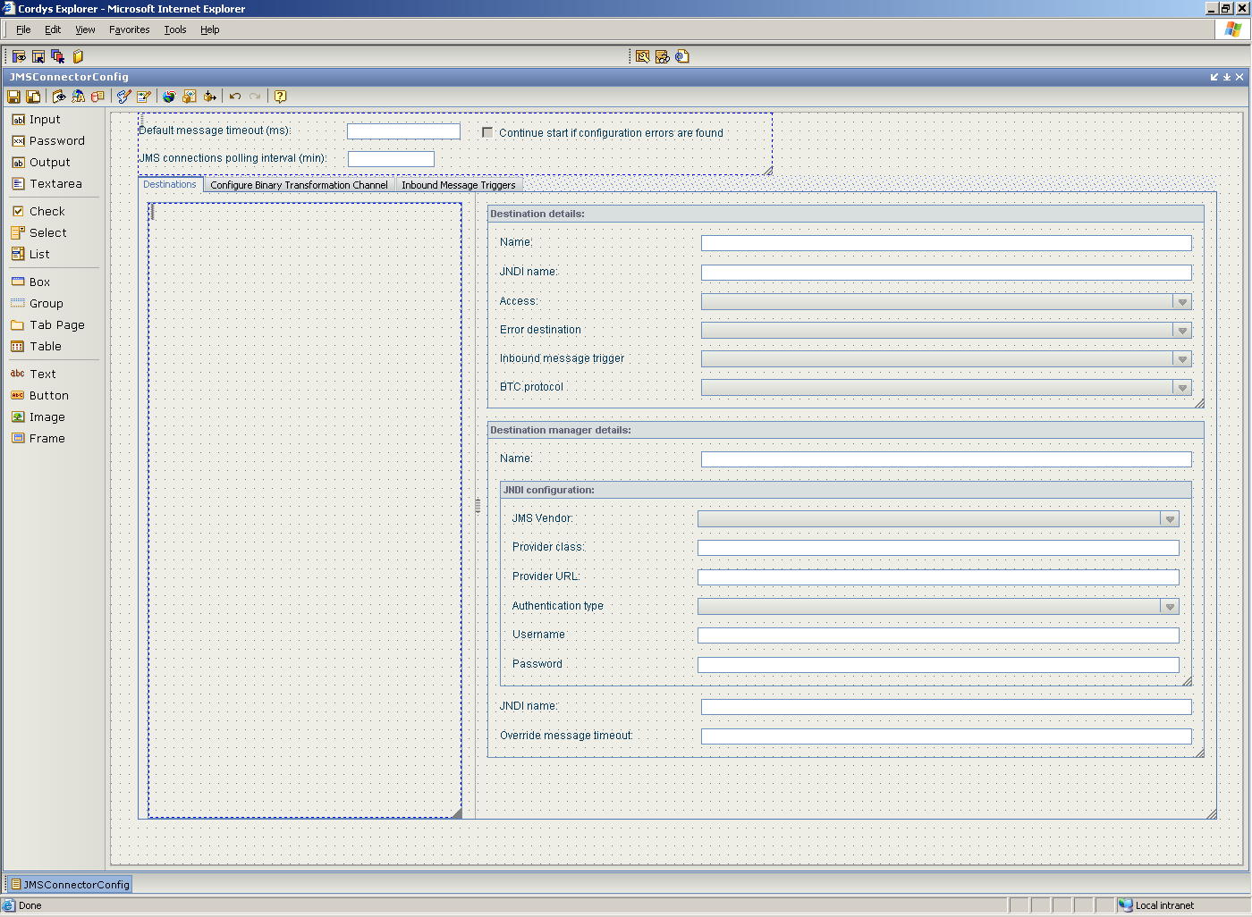
XForm JMSConnectorConfig: General
tabpageDestinations
check1
inpDefaultMessageTimeout
tabpageBTC
inpPollingInterval
tabpageMessageTriggers

Slide 23
XForm JMSConnectorConfig: Tab tabpageDestinations
tabpageDestinations
treeDestinations
gbDestinationDetails
gbDestinationManagerDetails

Slide 24
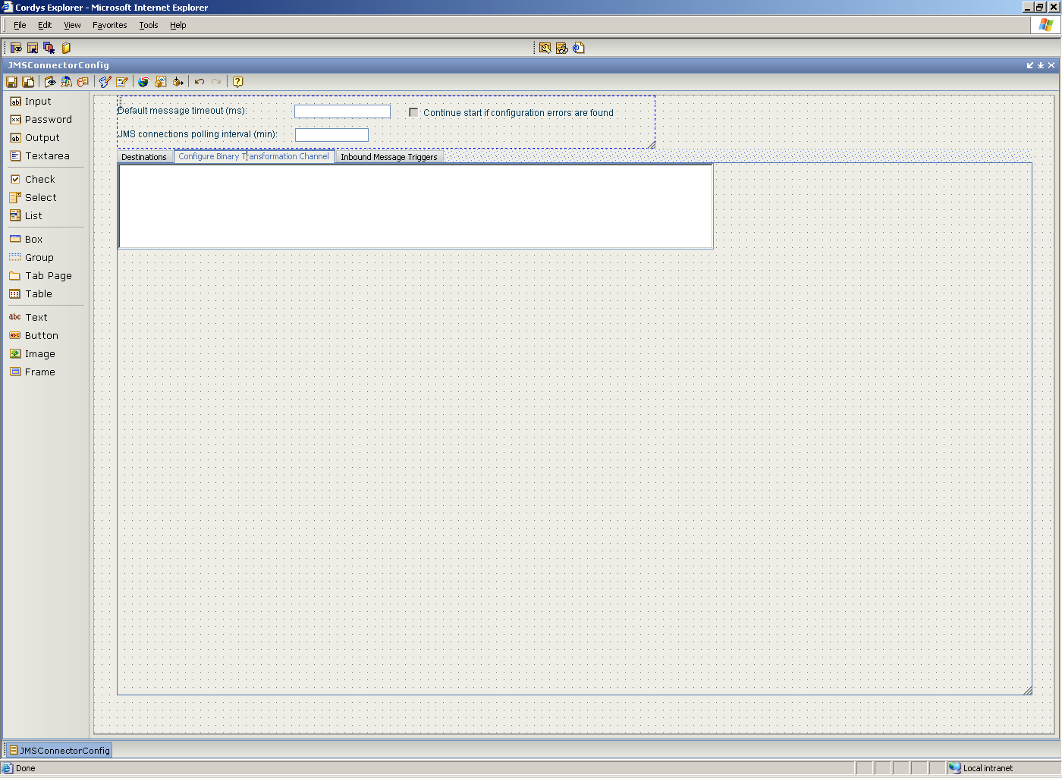
XForm JMSConnectorConfig: Tab tabpageBTC
tabpageBTC
frameConfigBTC

Slide 25
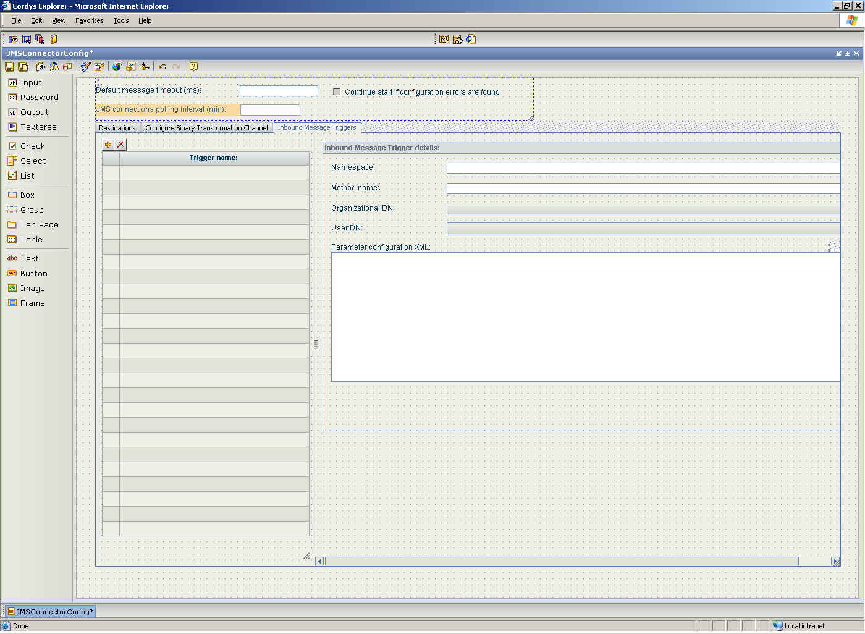
XForm JMSConnectorConfig: Tab tabpageMessageTriggers
tabpageMessageTriggers
gbTriggerDetails
tableTriggers
tableTriggers
textareaTriggerParameters

Slide 26
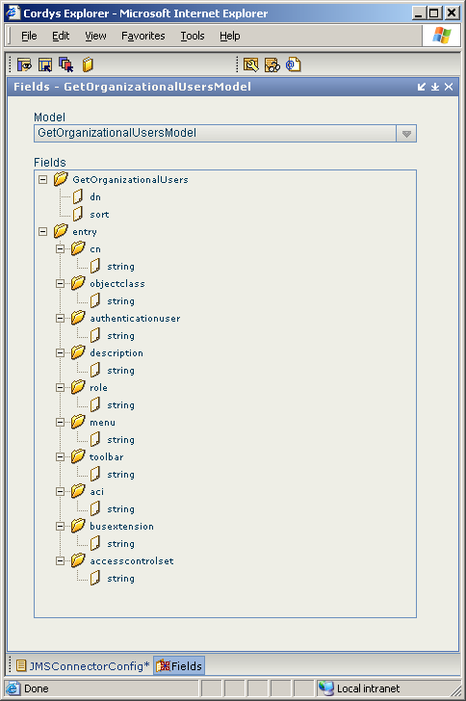

Slide 27
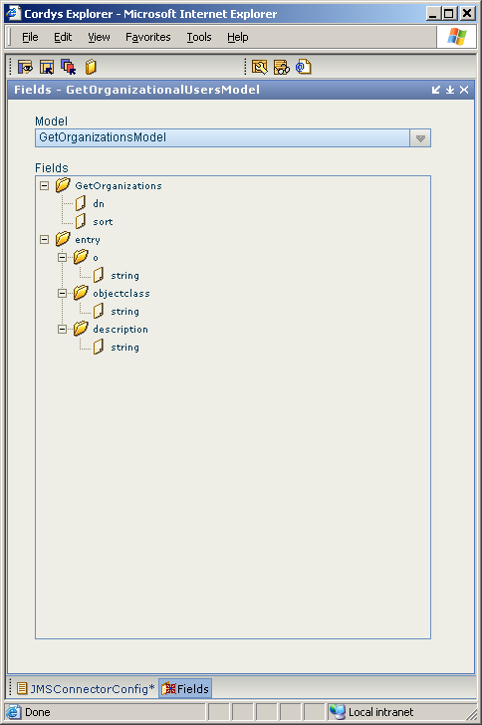

Slide 28
Models, Methods and Business Objects
OnRequest:GetOrganizationalUsersModel_OnRequest
OnResponse:GetOrganizationalUsersModel_OnResponse
Method:GetOrganizationalUsers
OnRequest:GetOrganizationsModel_OnRequest
Method:GetOrganizations
Methods
Models
GetOrganizationsModel
GetOrganizationalUsersModel
DestinationConfigurationModel
MainConfigModel
MessageTriggerModel
BO:entry
BO:DestinationManager
BO:configuration
BO:Trigger
BO:entry
Business Objects

